Slide 1
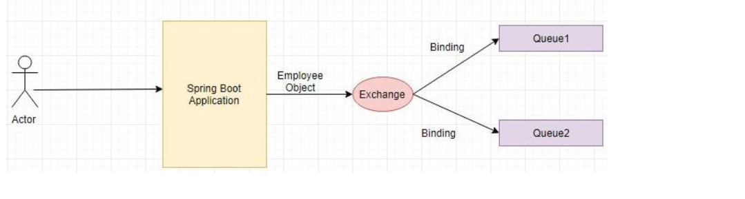
RABIT MQ + Spring Boot

Slide 2
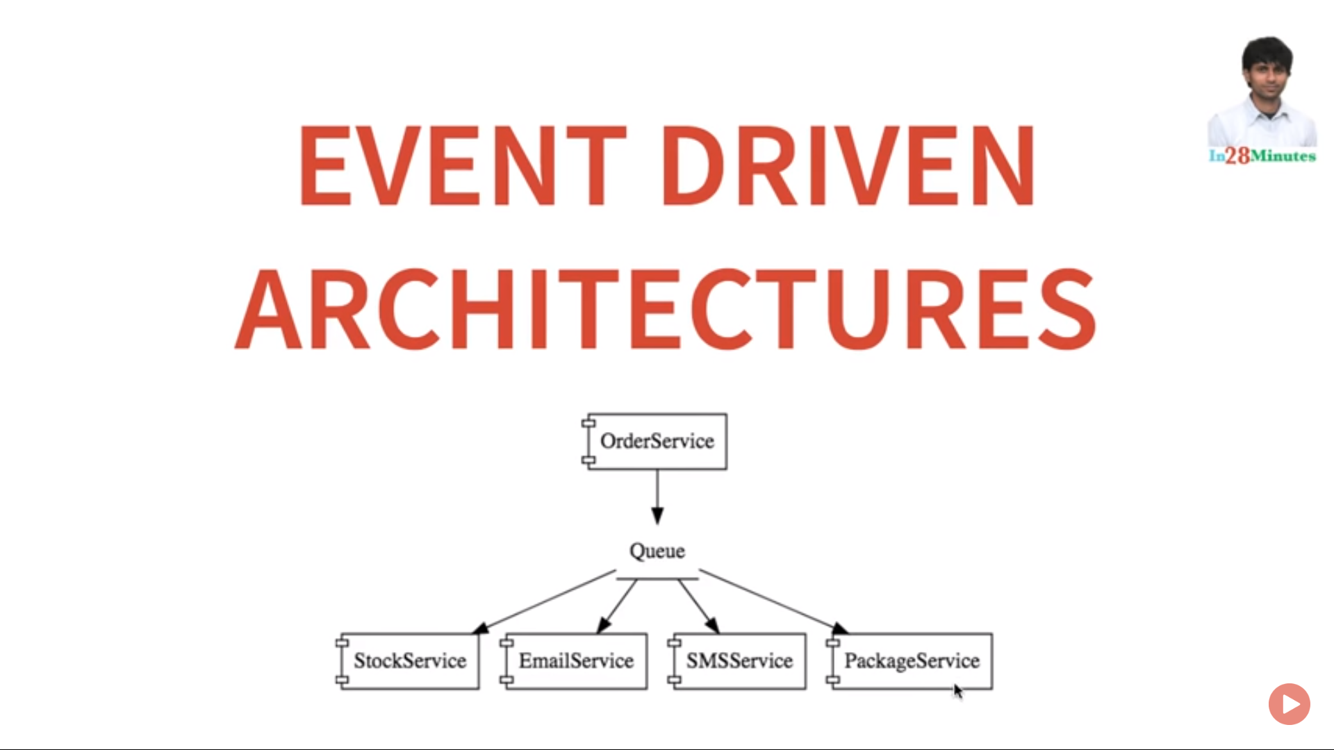



Slide 3
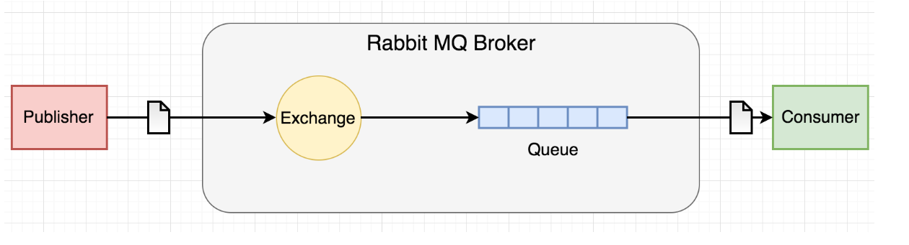
RABIT MQ + Spring Boot

Slide 4
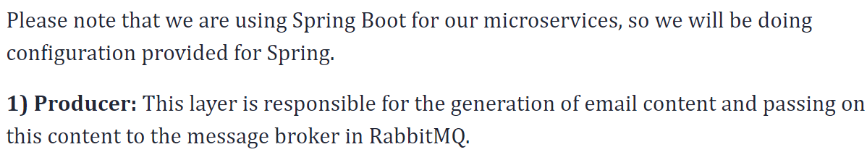
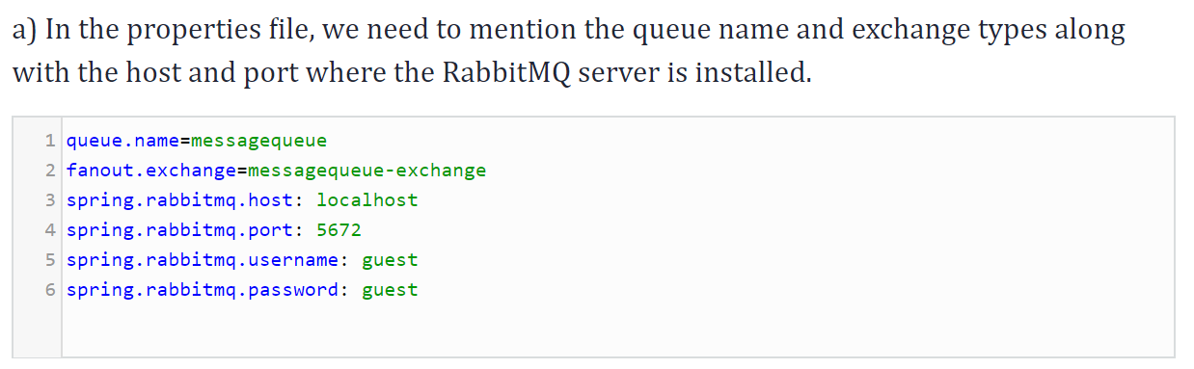
RABIT MQ + Spring Boot

Slide 5
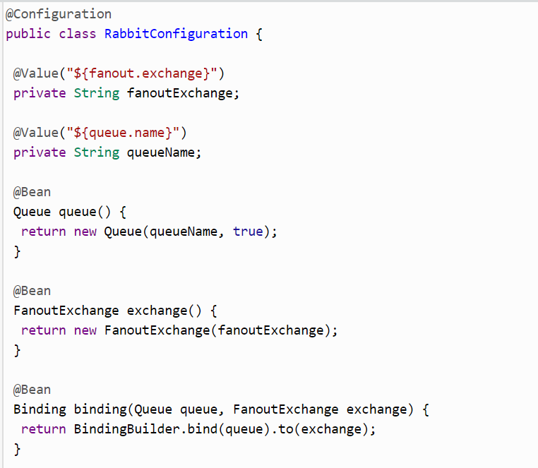
RABIT MQ + Spring Boot

Slide 6
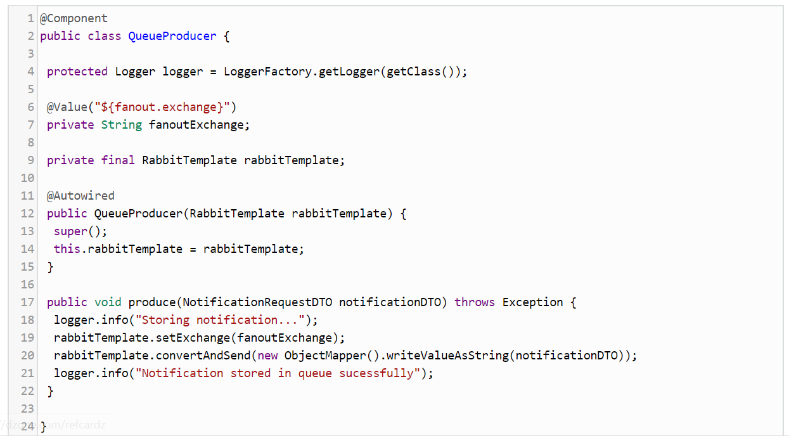
RABIT MQ + Spring Boot

Slide 7
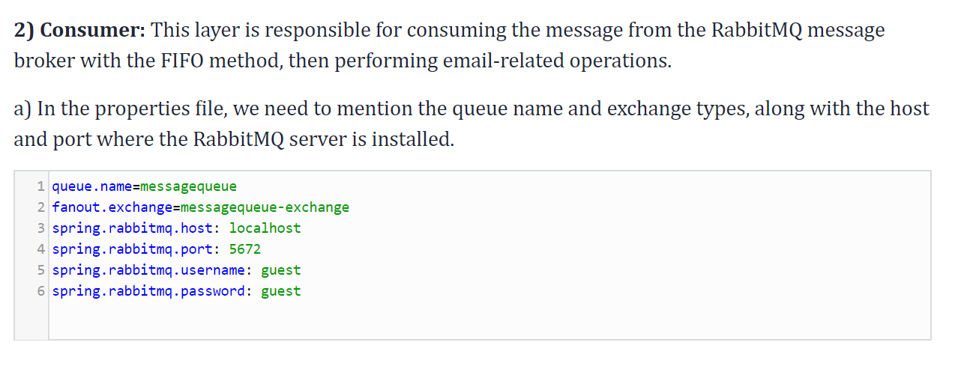
RABIT MQ + Spring Boot

Slide 8
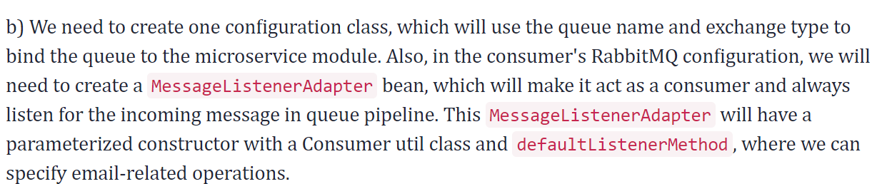
RABIT MQ + Spring Boot

Slide 9
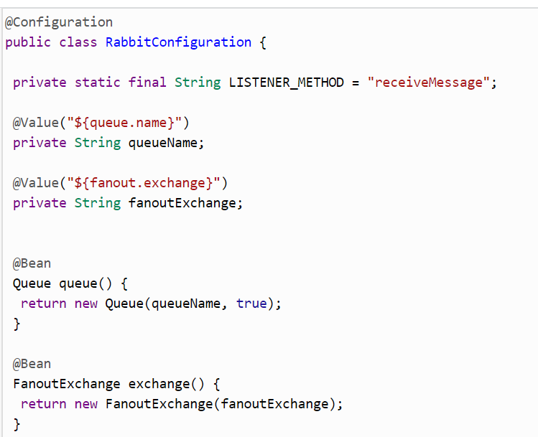
RABIT MQ + Spring Boot

Slide 10
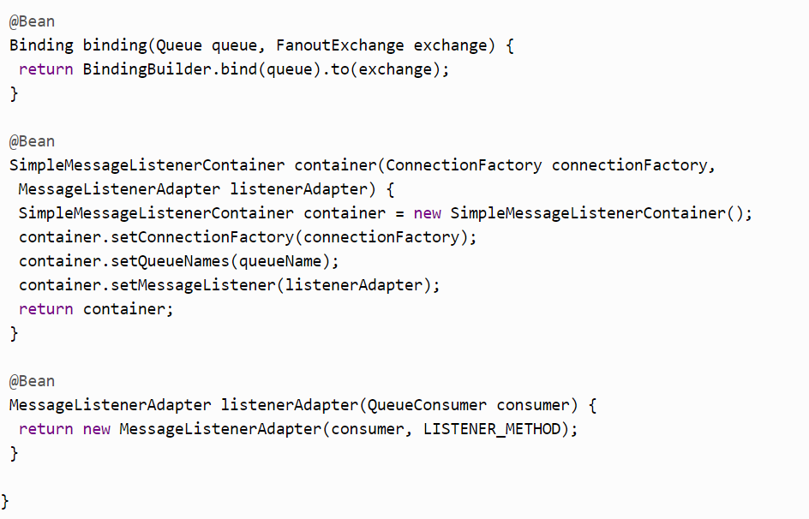
RABIT MQ + Spring Boot

Slide 11
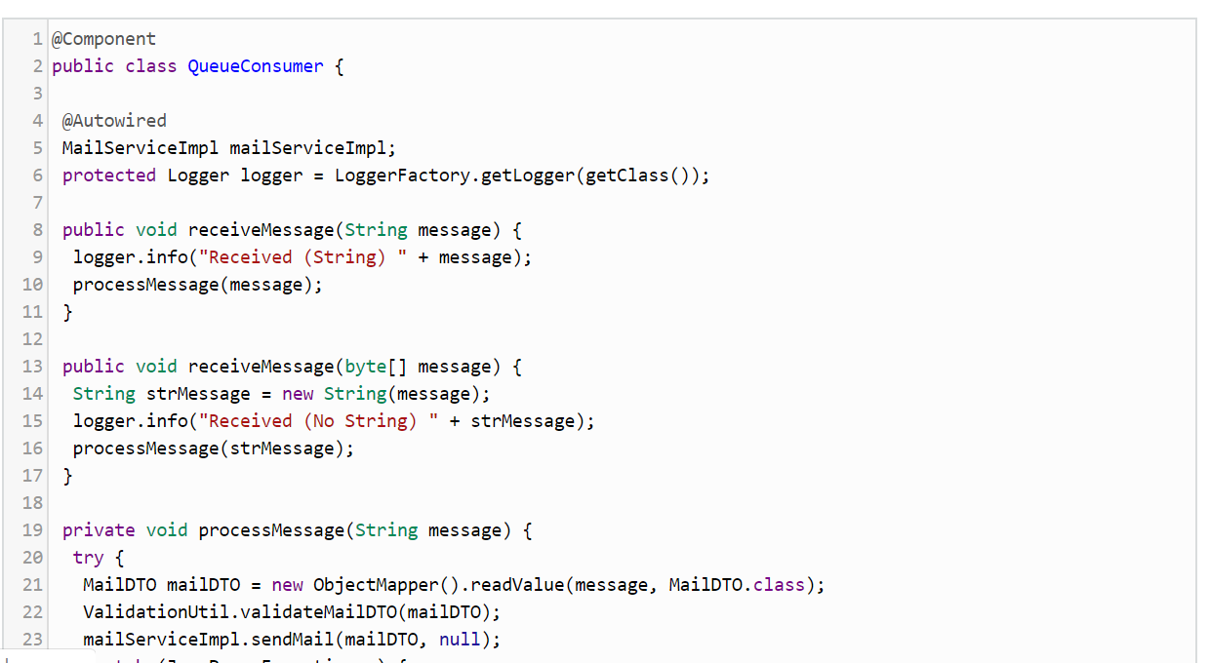
RABIT MQ + Spring Boot

Slide 12
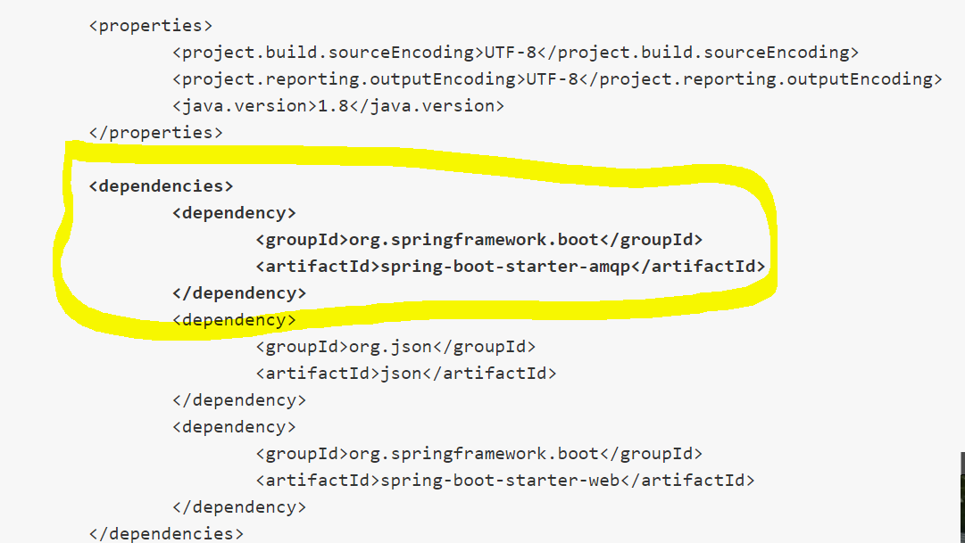
RABIT MQ + Spring Boot

Slide 13
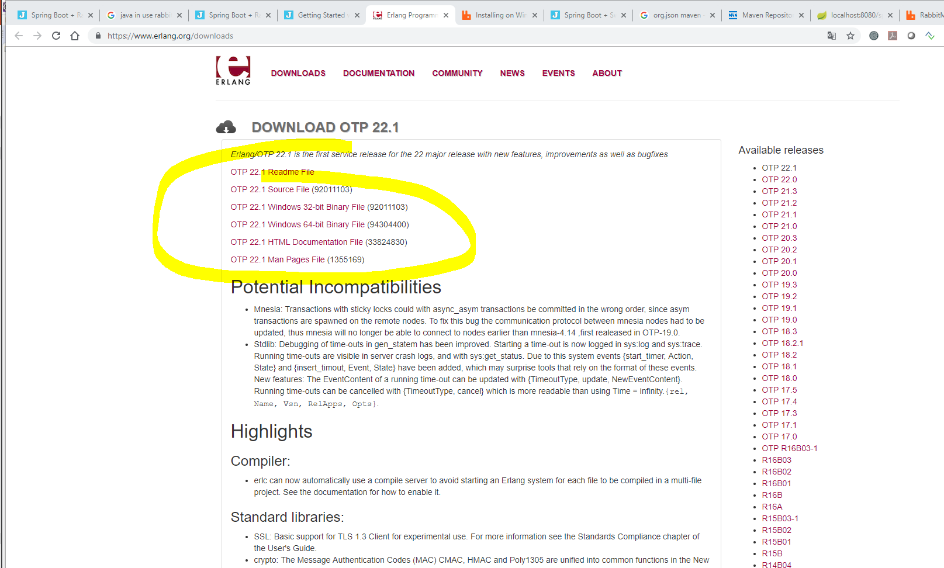
RABIT MQ + Spring Boot

Slide 14
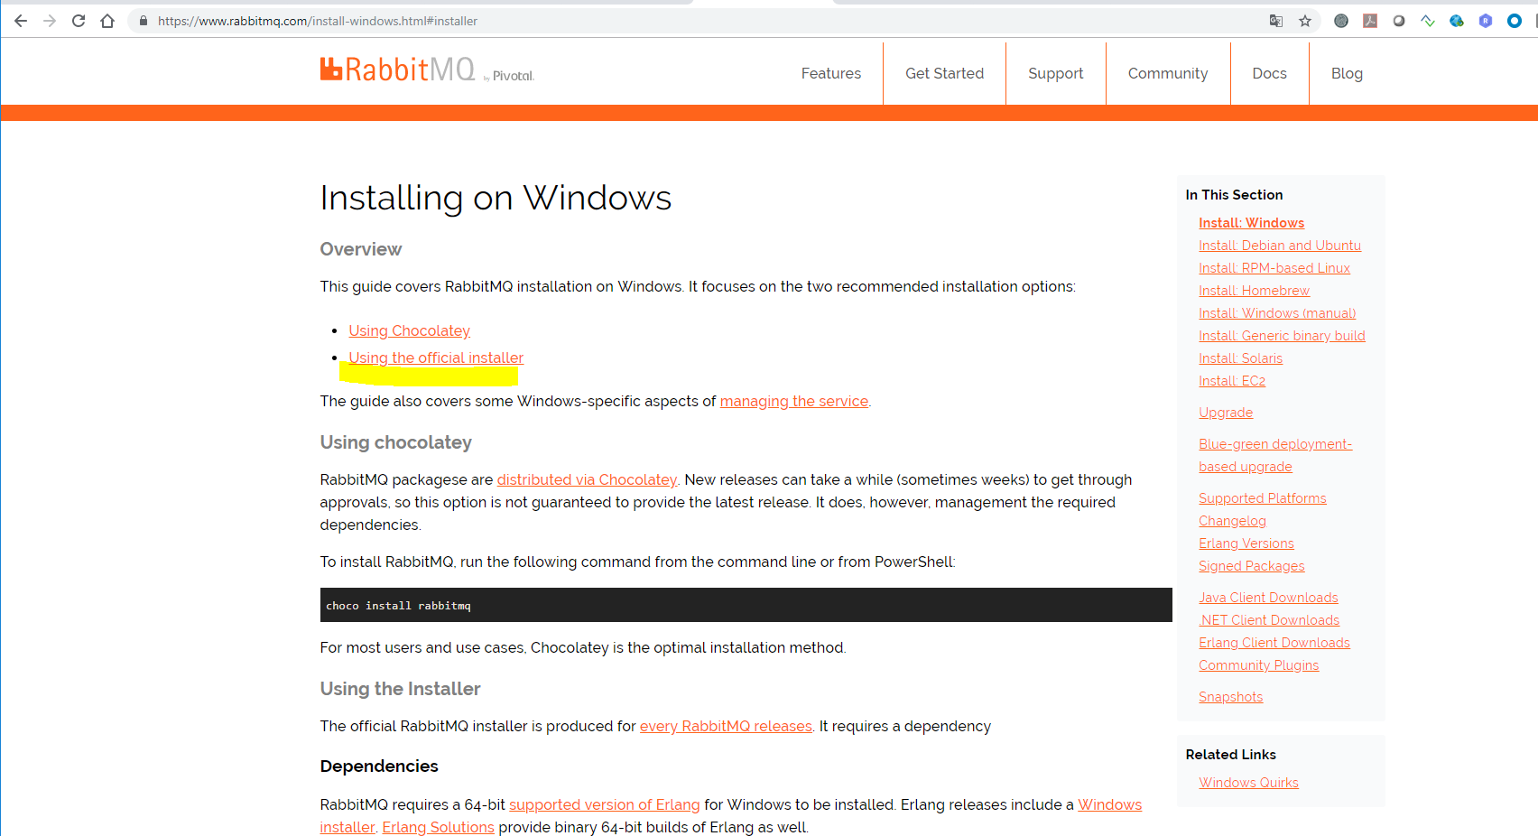
RABIT MQ + Spring Boot

Slide 15
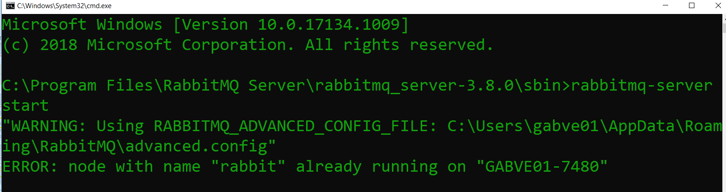
RABIT MQ + Spring Boot
Starting Queue Service

Slide 16
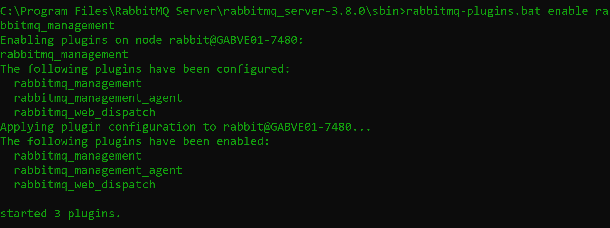
RABIT MQ + Spring Boot
Starting Console

Slide 17
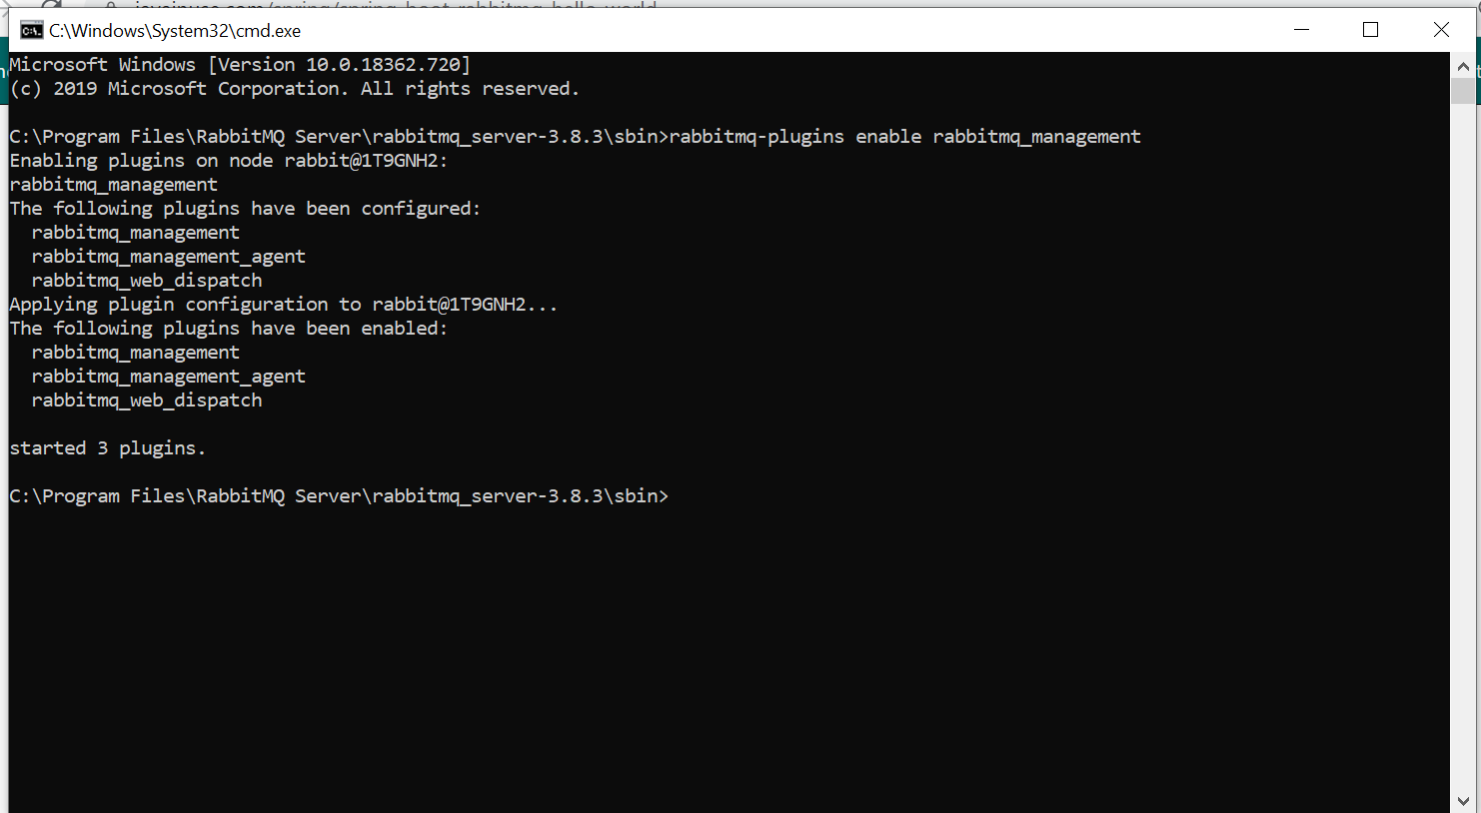
RABIT MQ + Spring Boot
Starting Console

Slide 18
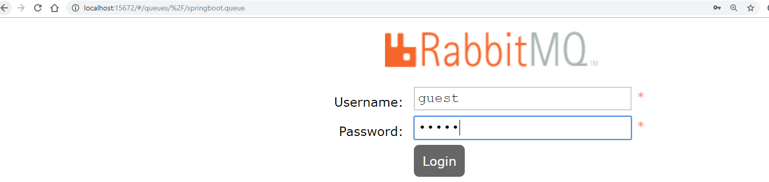
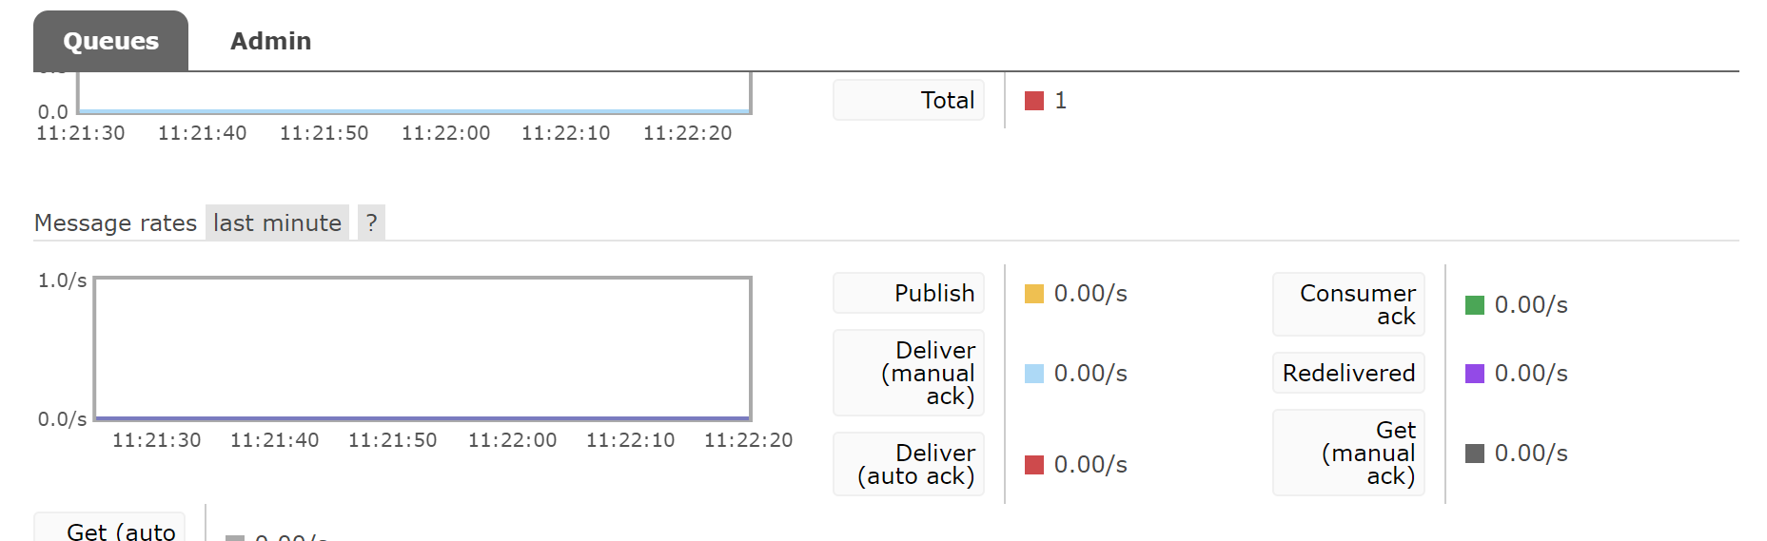
RABIT MQ + Spring Boot

Slide 19
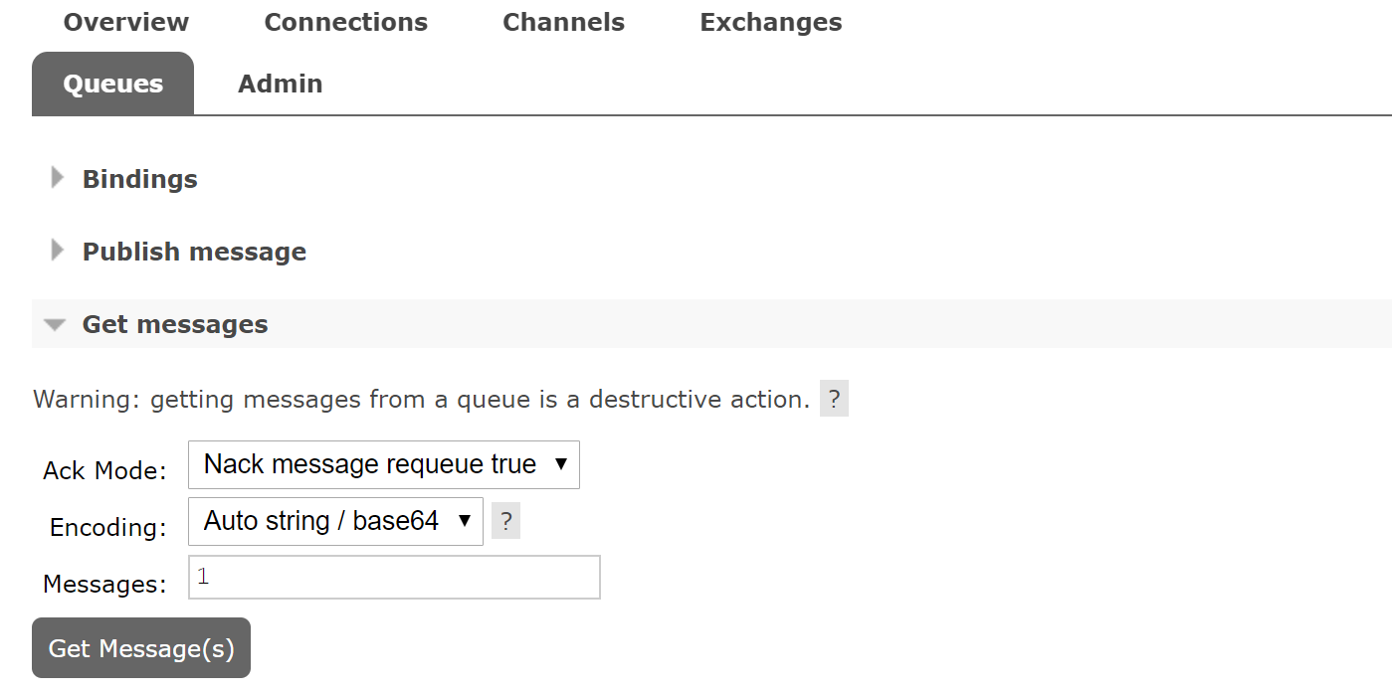
RABIT MQ + Spring Boot

Slide 20
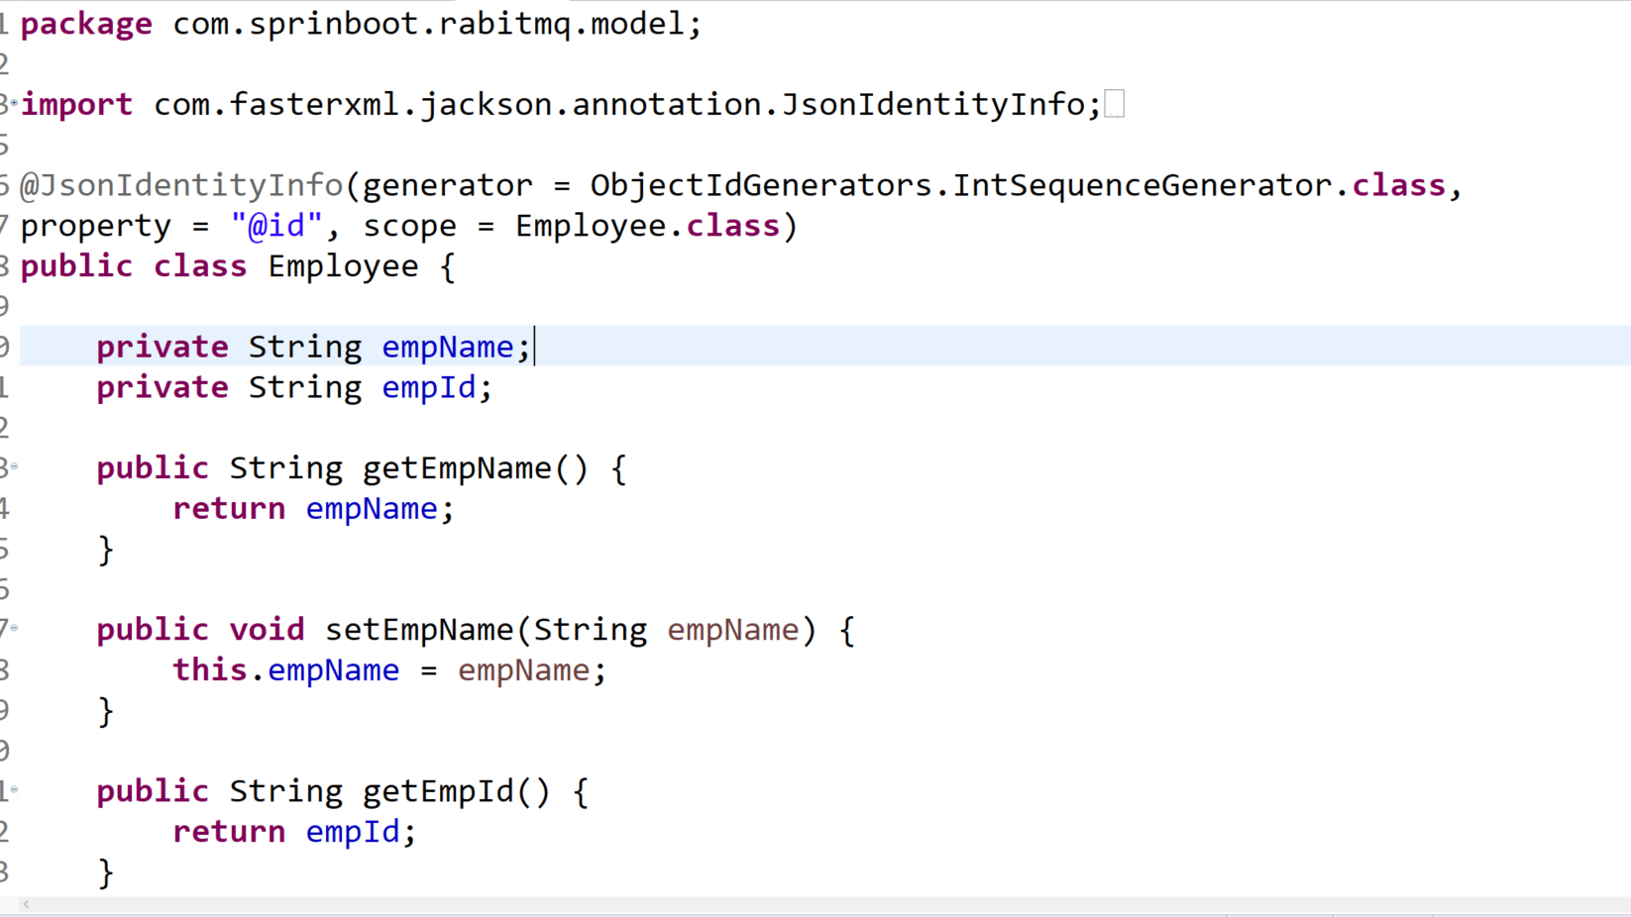
RABIT MQ + Spring Boot

Slide 21
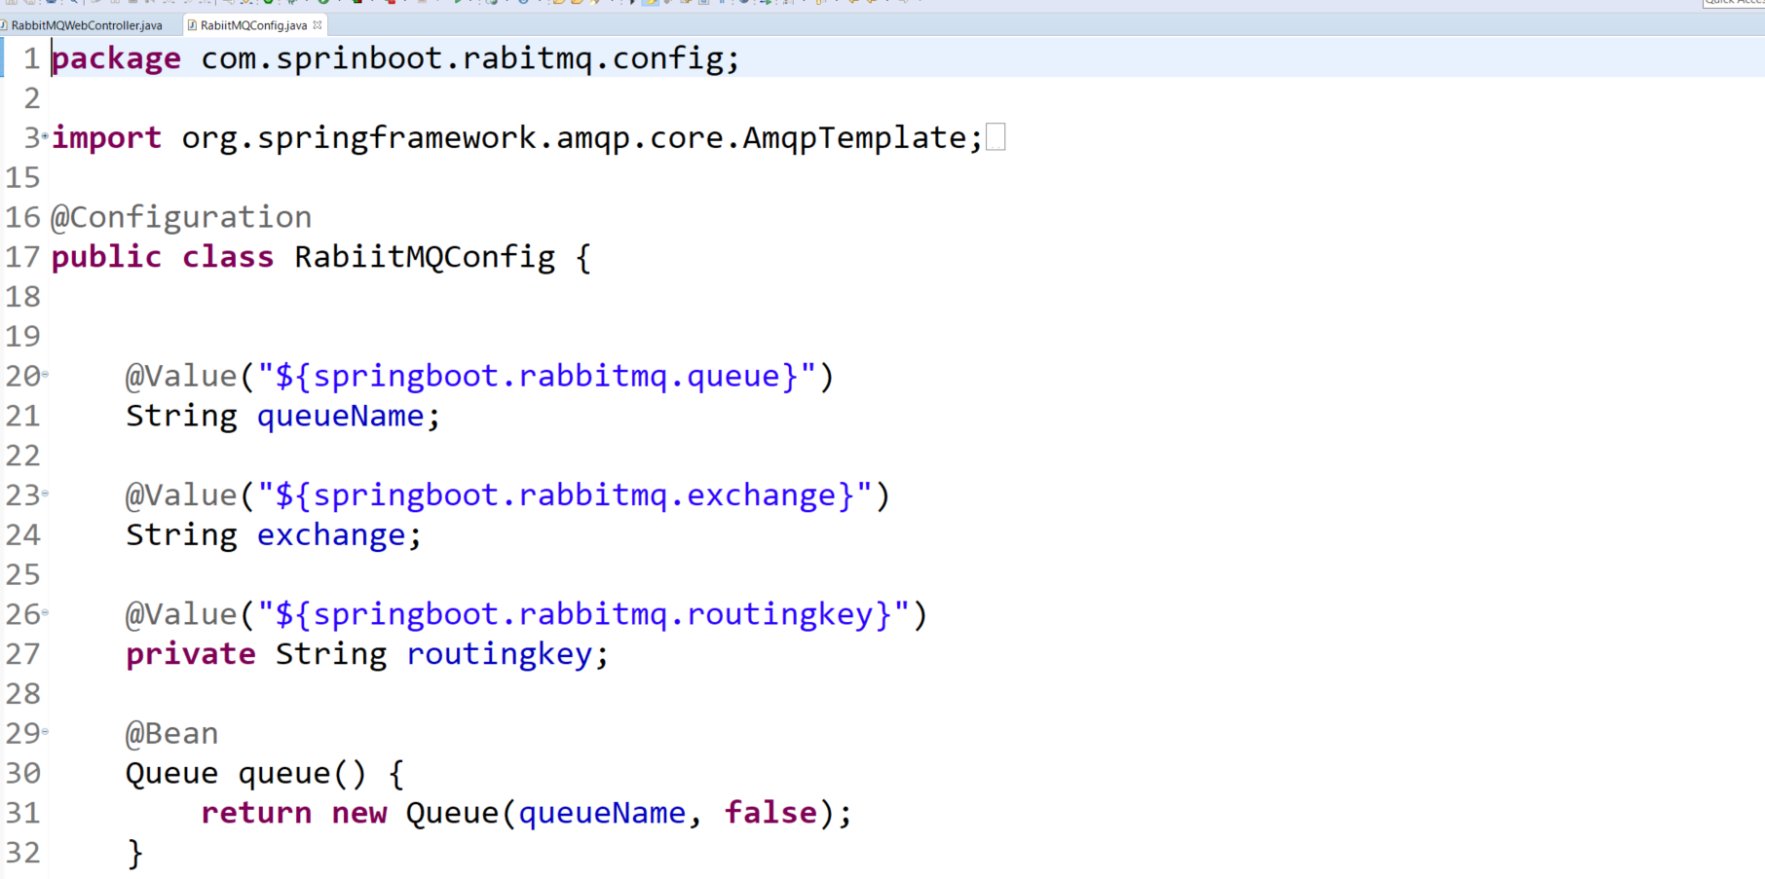
RABIT MQ + Spring Boot

Slide 22
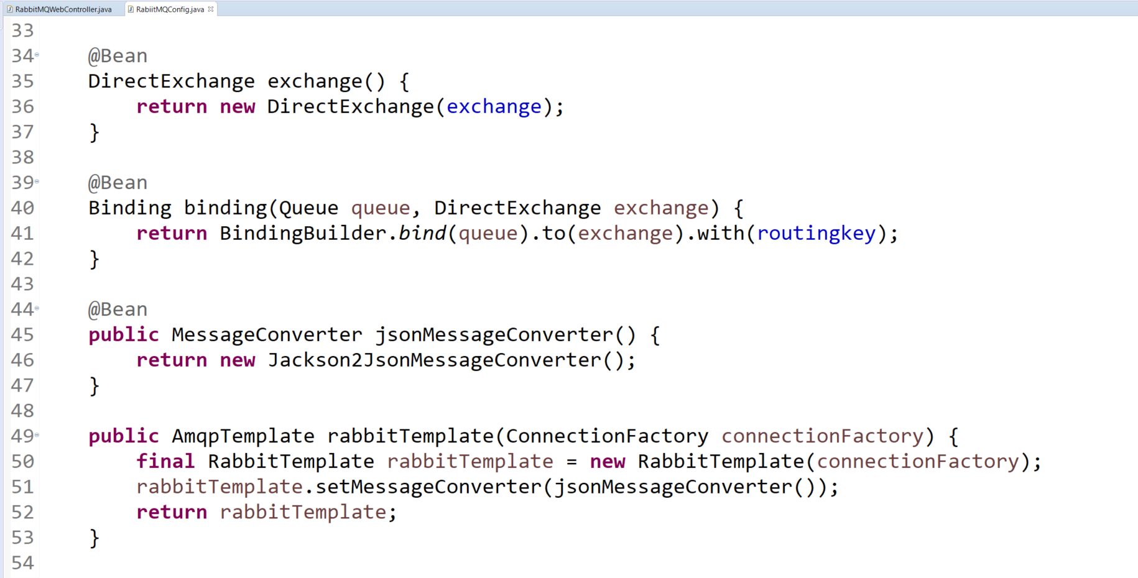
RABIT MQ + Spring Boot

Slide 23
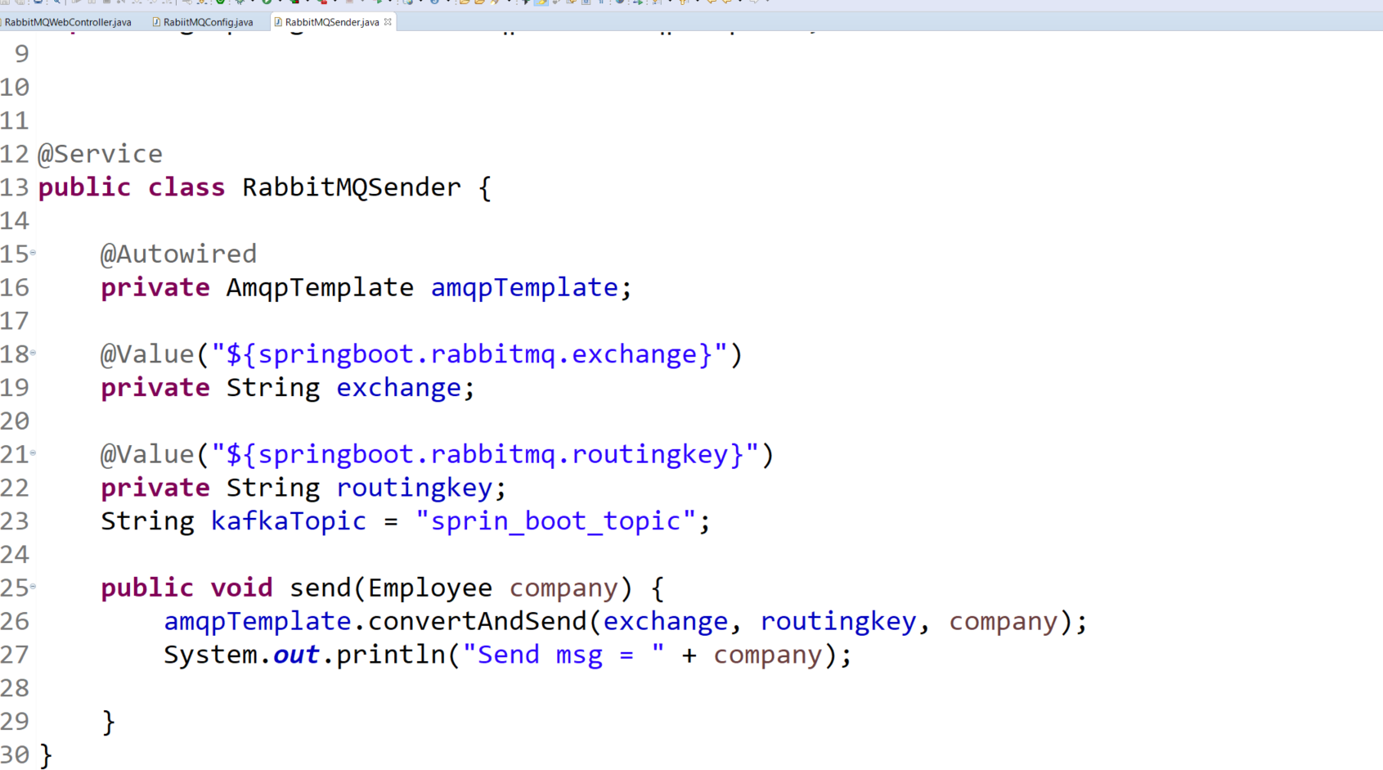
RABIT MQ + Spring Boot

Slide 24
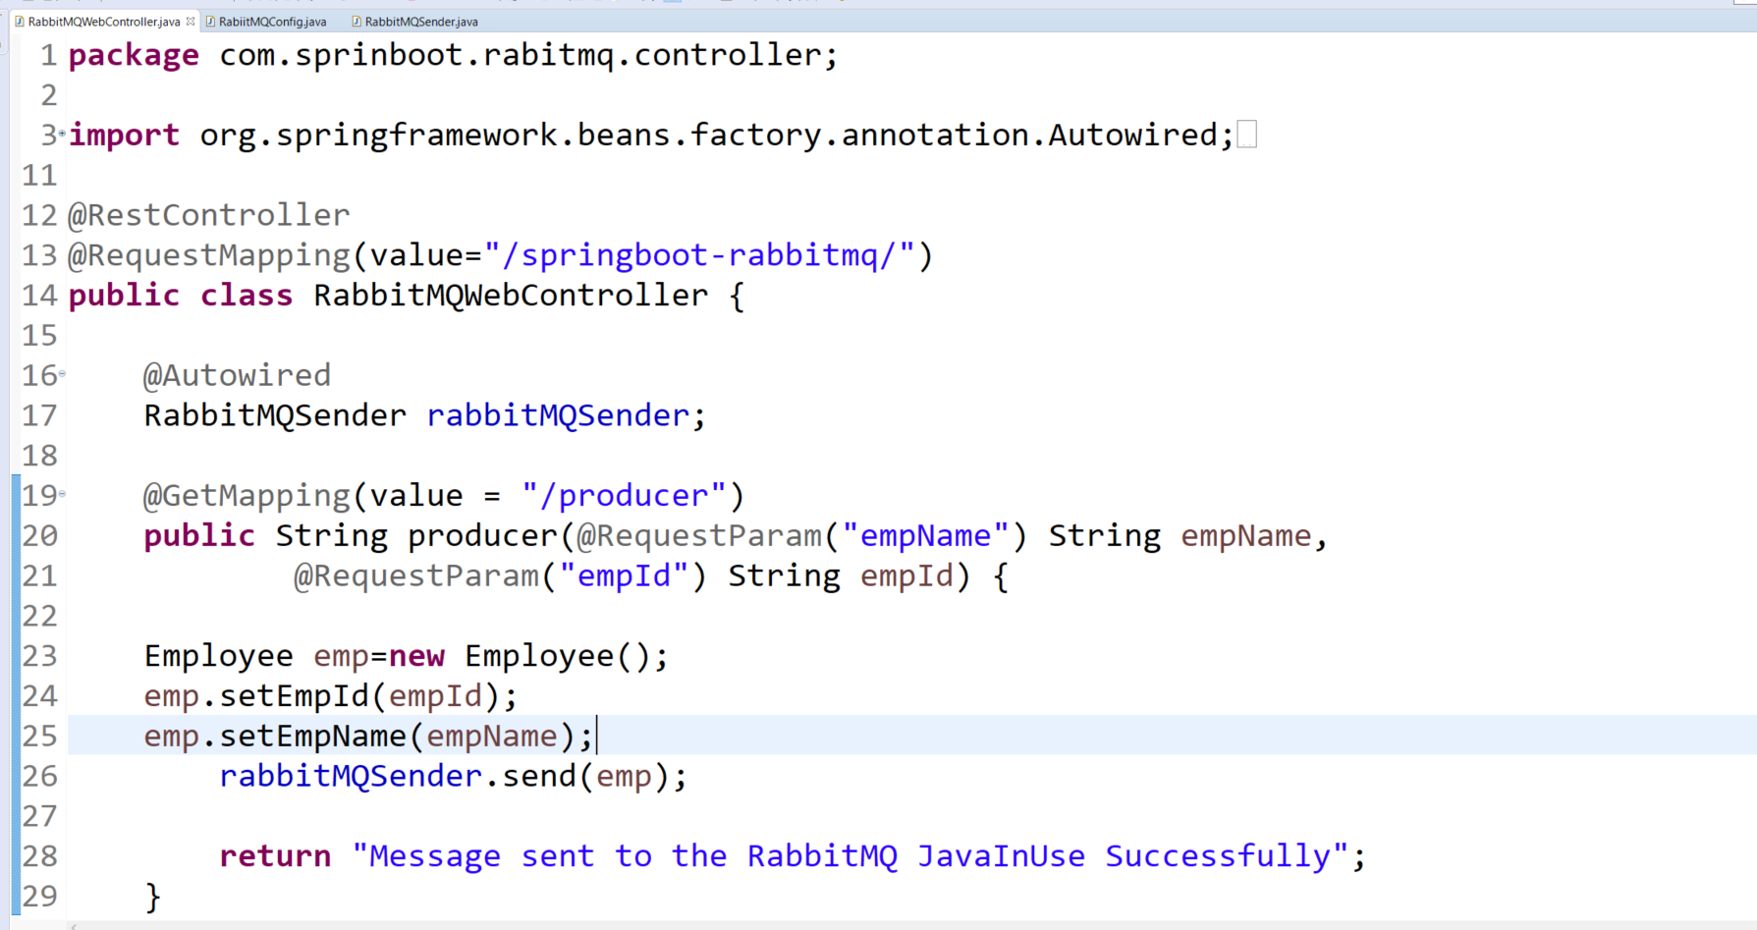
RABIT MQ + Spring Boot

Slide 25
RABIT MQ + Spring Boot

Slide 26
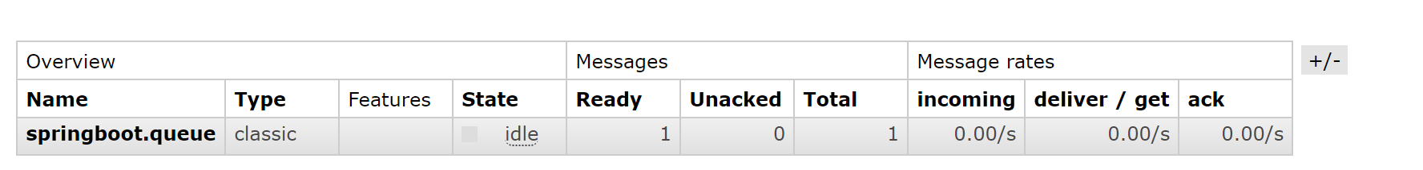
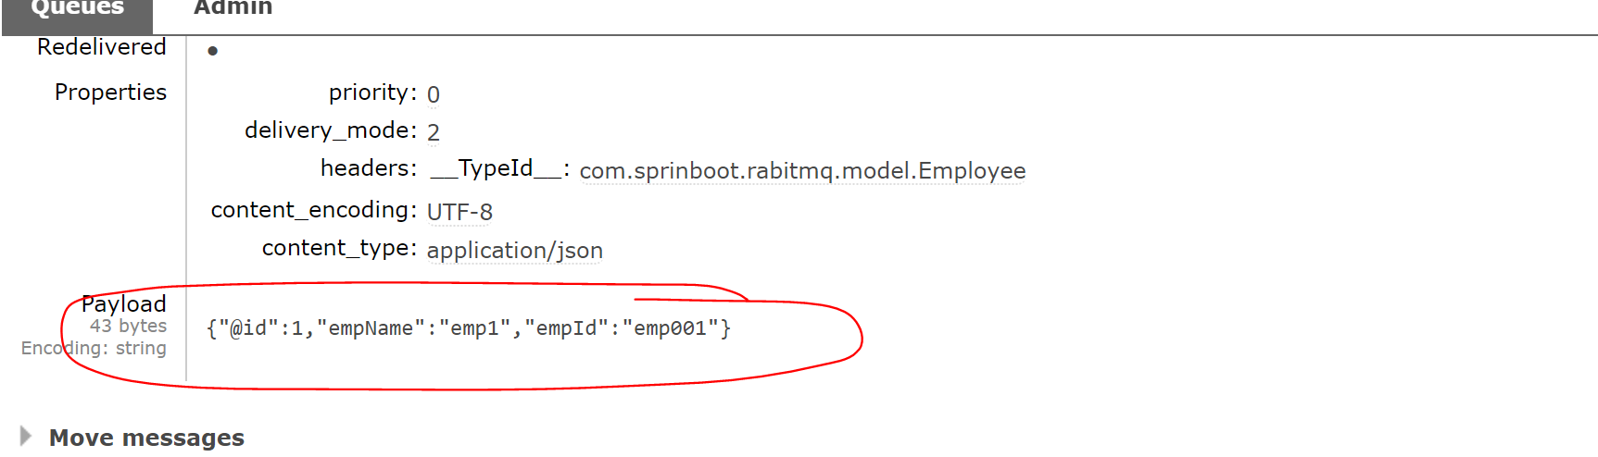
RABIT MQ + Spring Boot

Slide 27
Eclipse Project

Slide 28
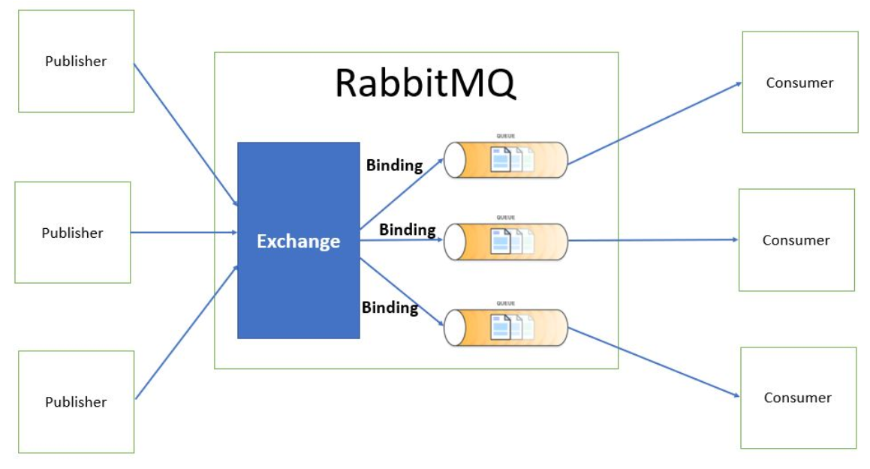
RABIT MQ Exchange Types

Slide 29
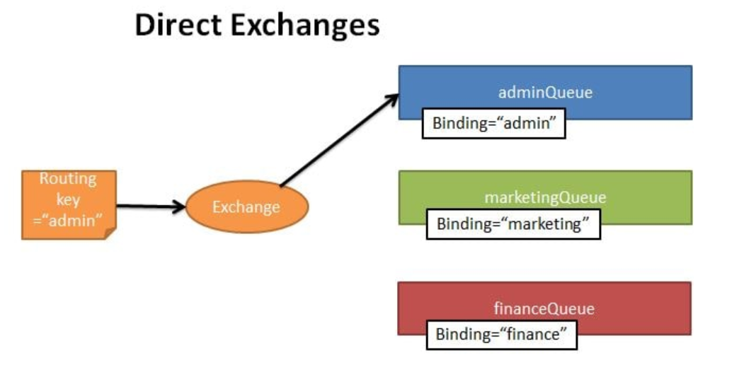
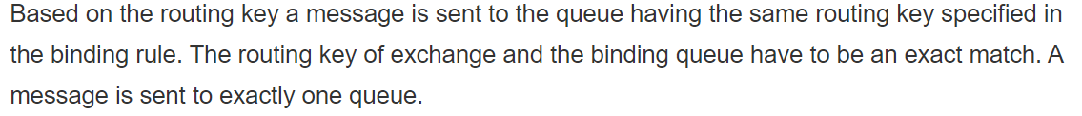
RABIT MQ Exchange Types

Slide 30
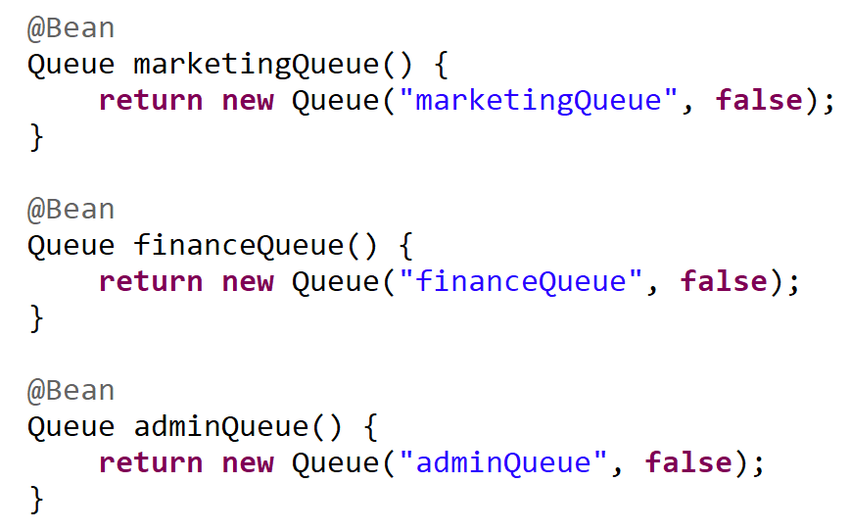
RABIT MQ Exchange Types

Slide 31
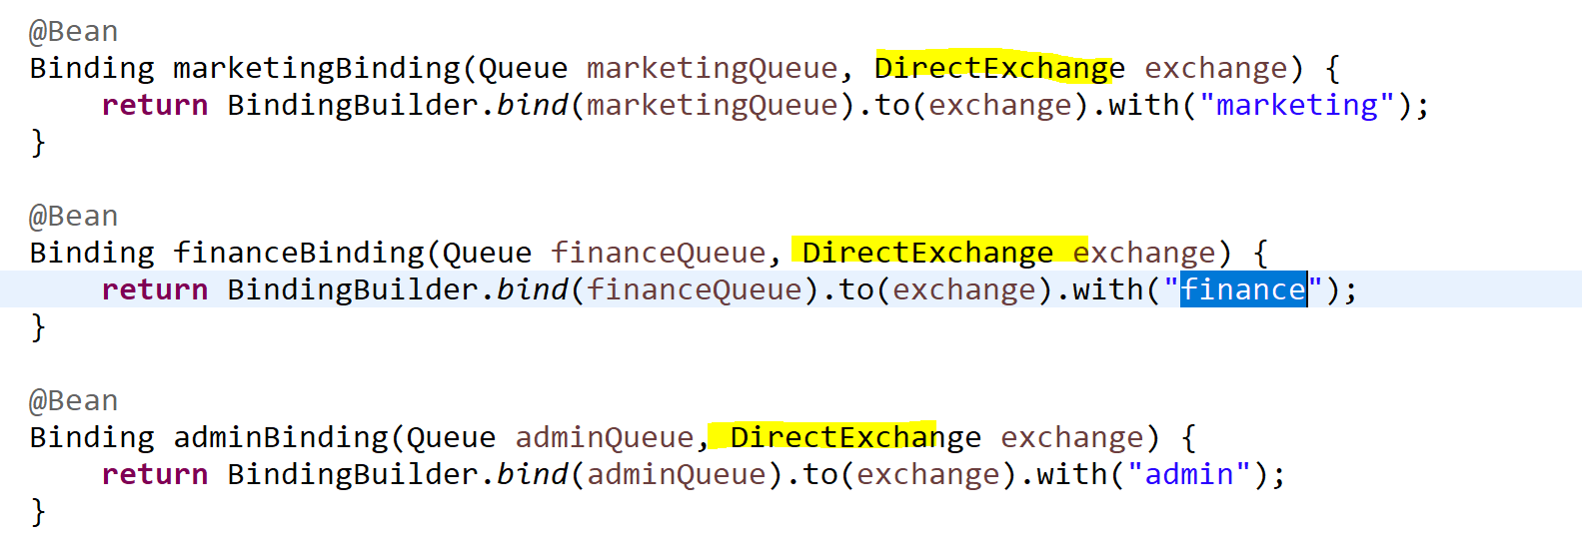
RABIT MQ Exchange Types

Slide 32
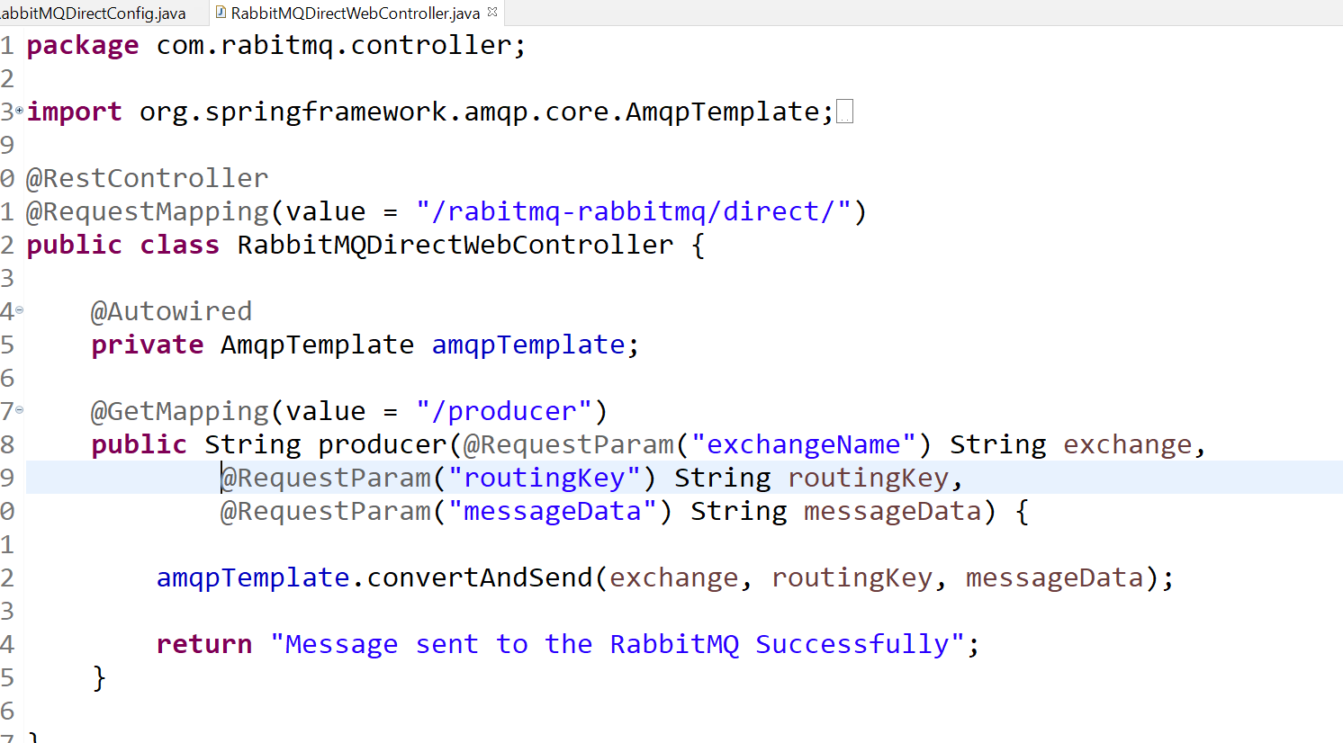
RABIT MQ Exchange Types

Slide 33
RABIT MQ Exchange Types with direct q having AdminQueu
http://localhost:8080/rabitmq-rabbitmq/direct/producer?exchangeName=direct-exchange&routingKey=admin&messageData=HelloWorldRabitMQ
RABIT MQ Exchange Types with direct q having Marketing
http://localhost:8080/rabitmq-rabbitmq/direct/producer?exchangeName=direct-exchange&routingKey=marketing&messageData=HelloWorldMarketingRabitMQ
RABIT MQ Exchange Types with direct q having FinanceQueu
http://localhost:8080/rabitmq-rabbitmq/direct/producer?exchangeName=direct-exchange&routingKey=finance&messageData=HelloWorldfinanceRabitMQ

Slide 34
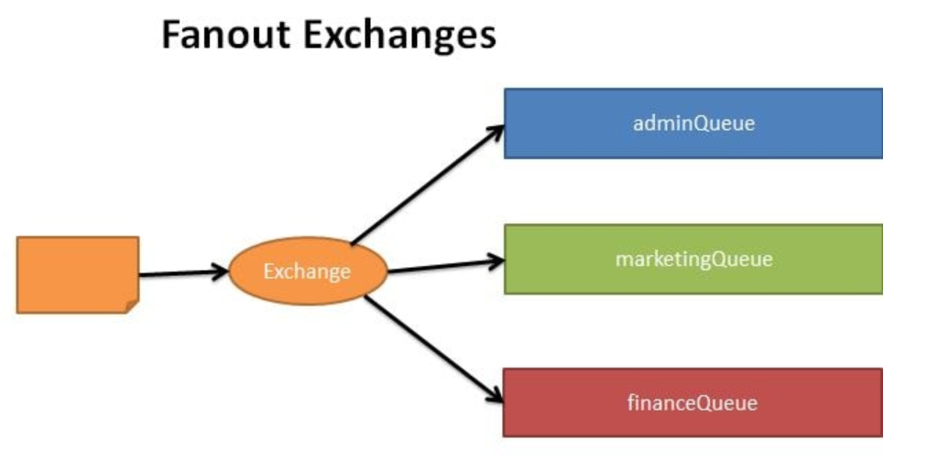
RABIT MQ Exchange Types

Slide 35
RABIT MQ Exchange Types

Slide 36
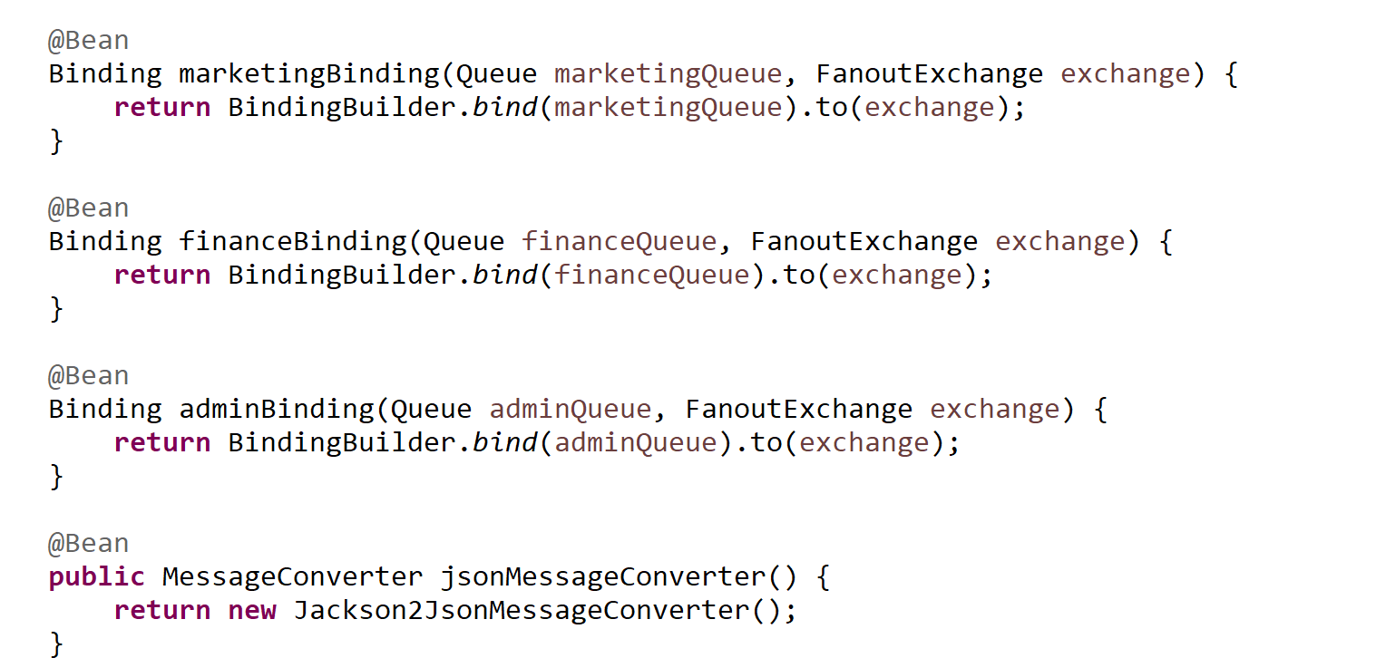
RABIT MQ Exchange Types

Slide 37
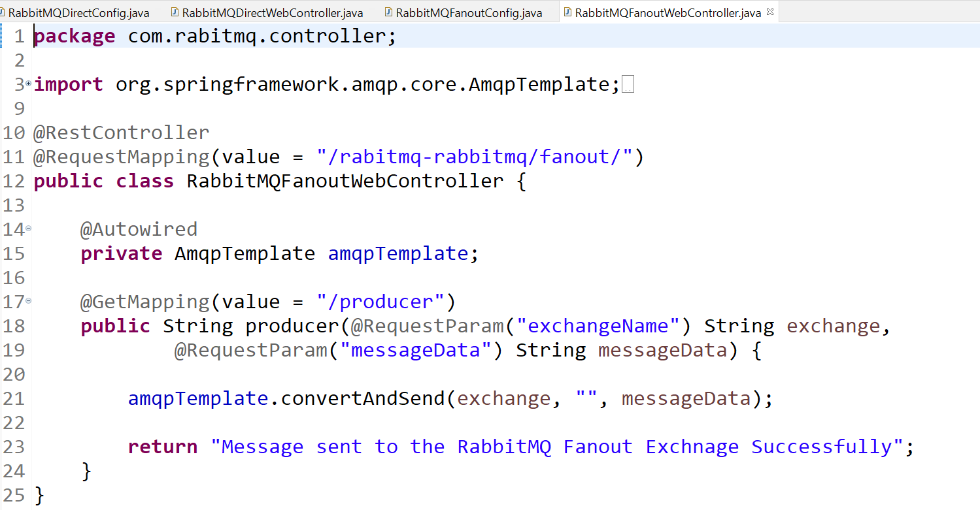
RABIT MQ Exchange Types

Slide 38
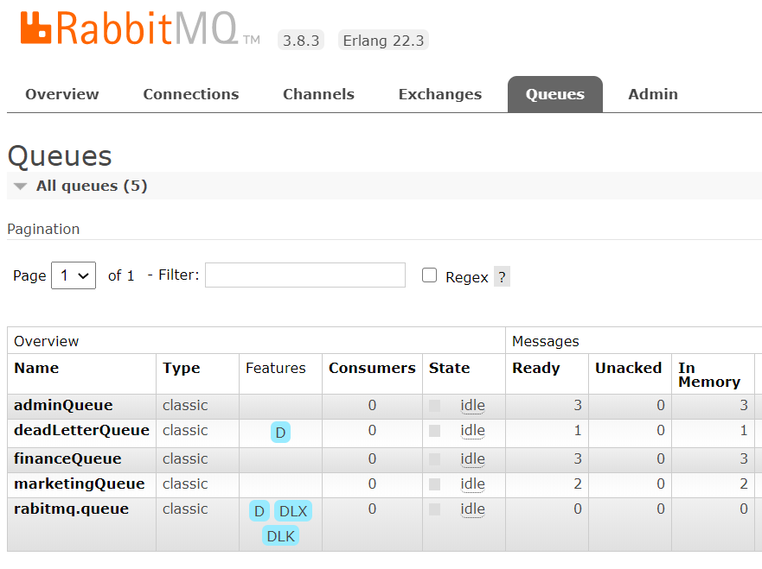
RABIT MQ Exchange Types with Fanout q having AdminQueu
http://localhost:8080/rabitmq-rabbitmq/fanout/producer?exchangeName=fanout-exchange&messageData=HelloWorldRabitmq

Slide 39
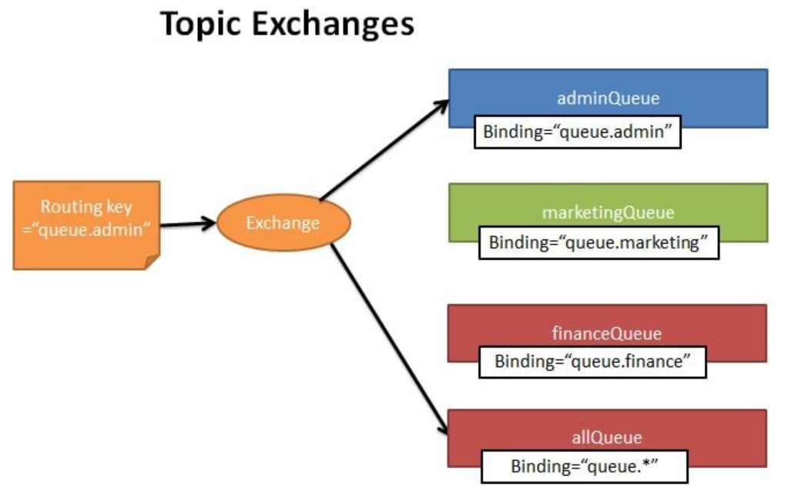
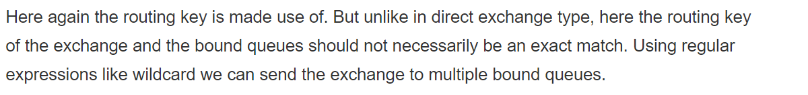
RABIT MQ Exchange Types

Slide 40
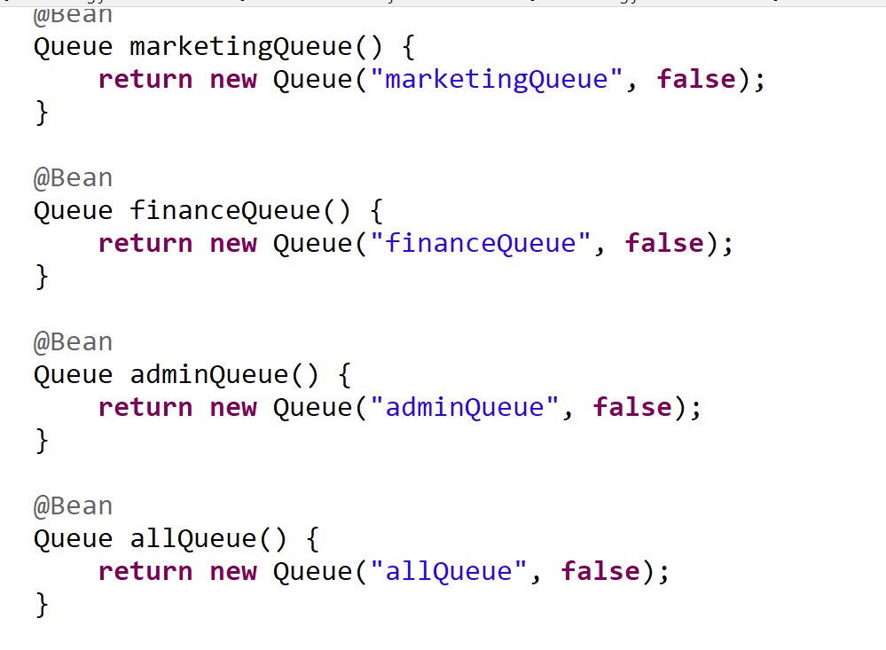
RABIT MQ Exchange Types

Slide 41
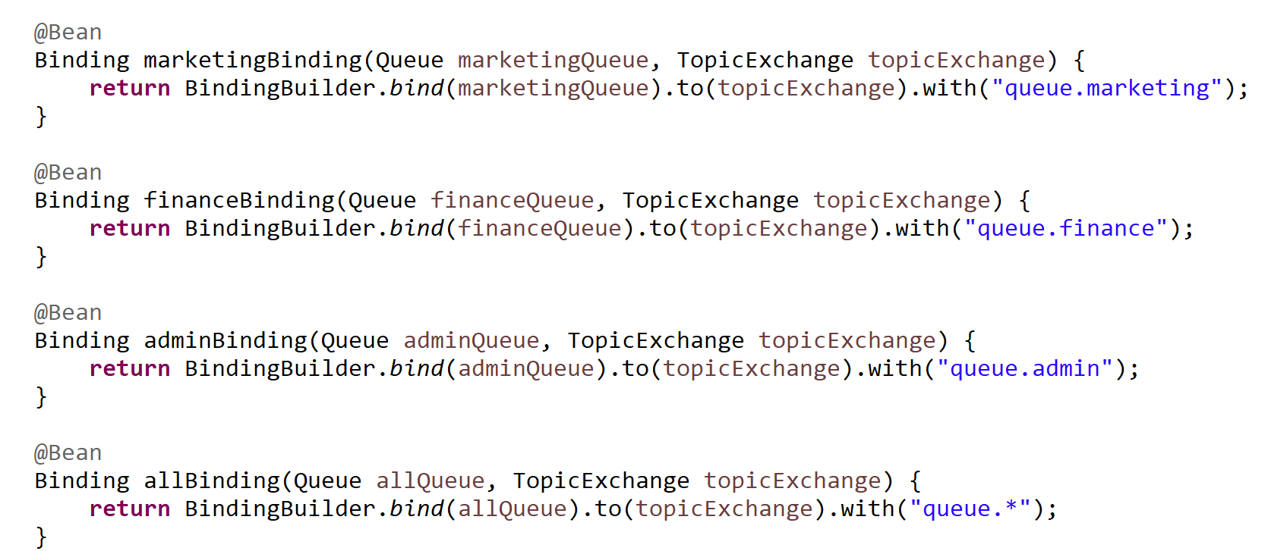
RABIT MQ Exchange Types

Slide 42
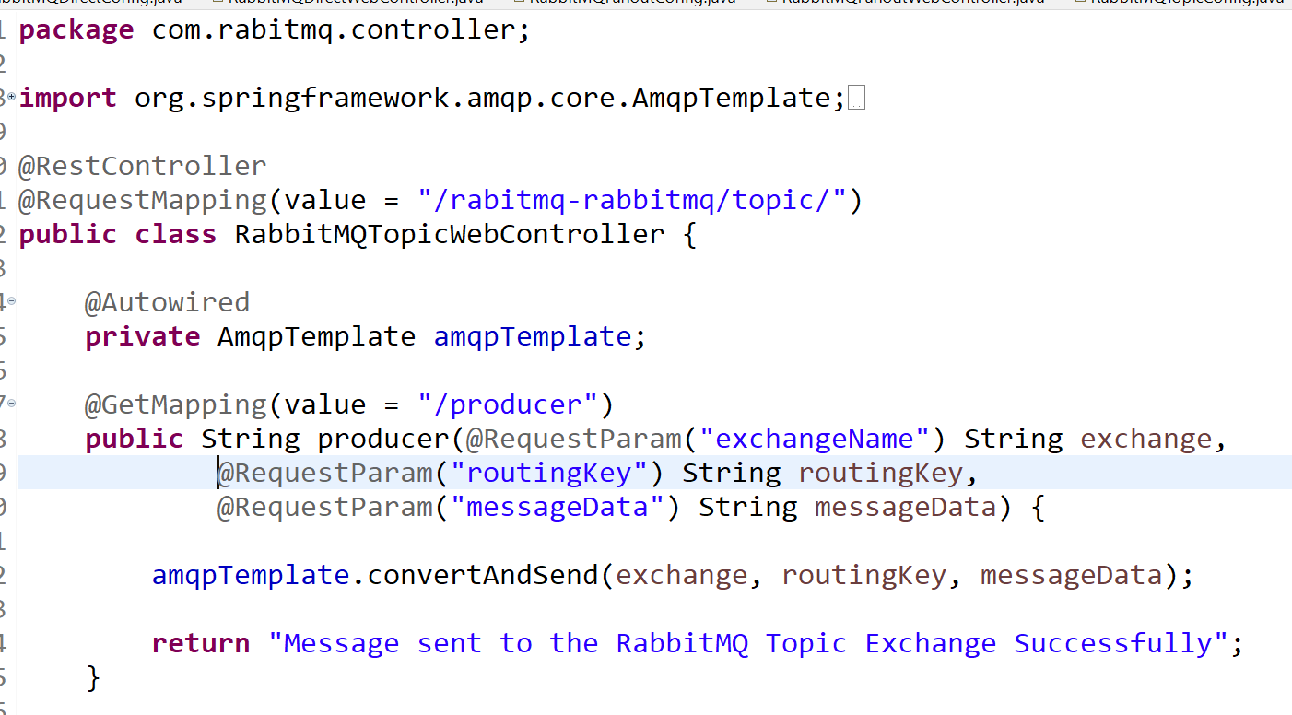
RABIT MQ Exchange Types

Slide 43
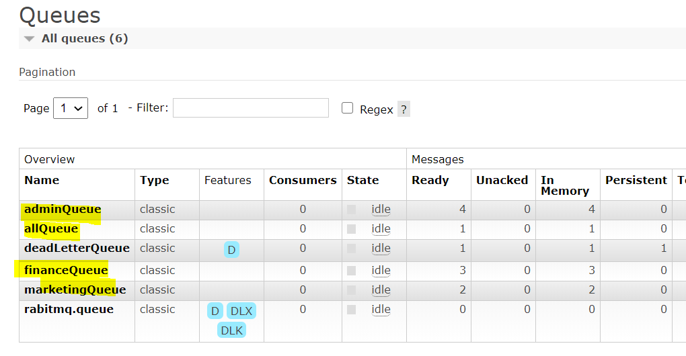
RABIT MQ Exchange Types with Topic Exchange q having AdminQueu
http://localhost:8080/rabitmq-rabbitmq/topic/producer?exchangeName=topic-exchange&routingKey=queue.admin&messageData=HelloWorldRabitMQTopicExhange

Slide 44

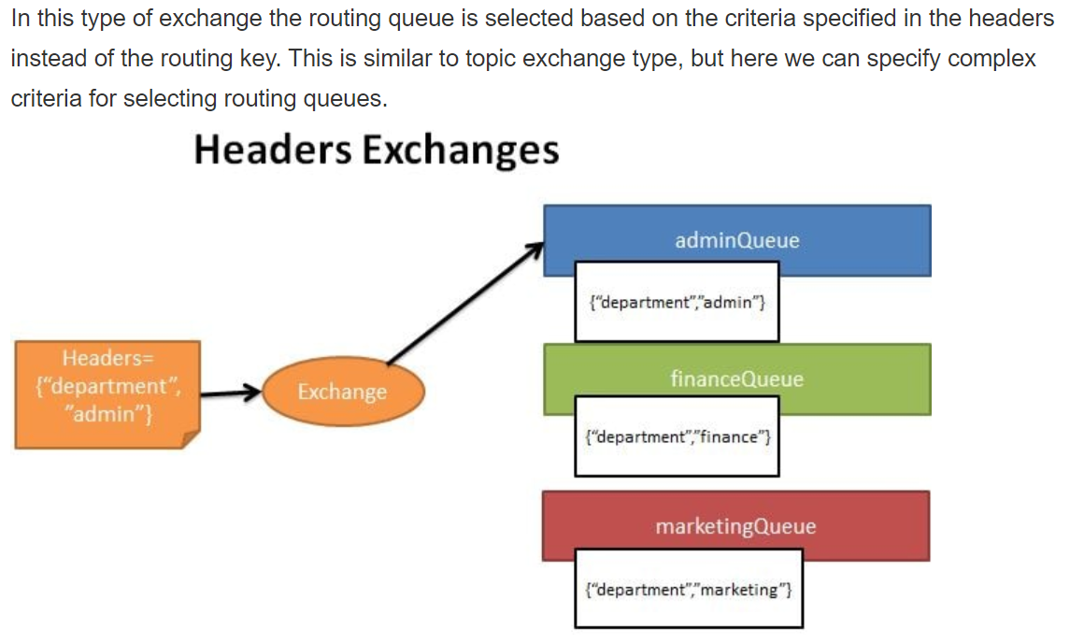
RABIT MQ Exchange Types

Slide 45
RABIT MQ Exchange Types

Slide 46
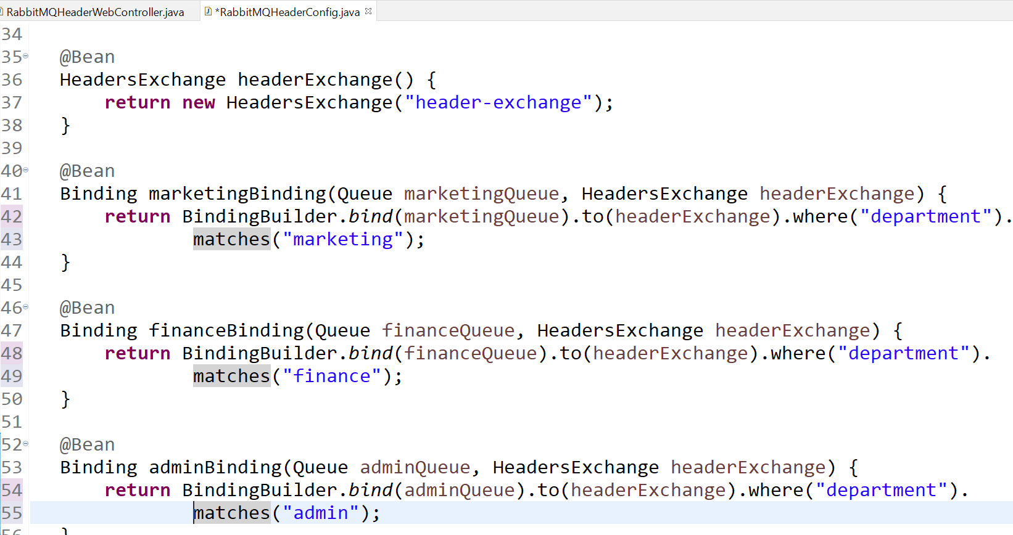
RABIT MQ Exchange Types

Slide 47
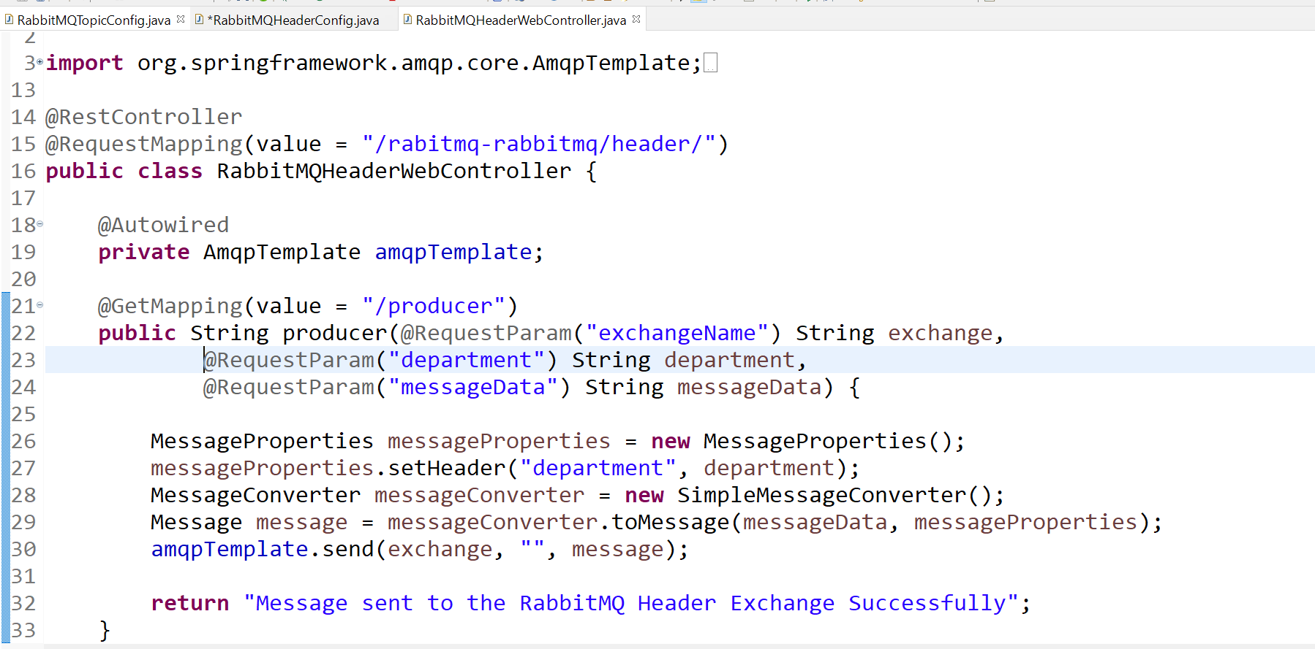
RABIT MQ Exchange Types

Slide 48
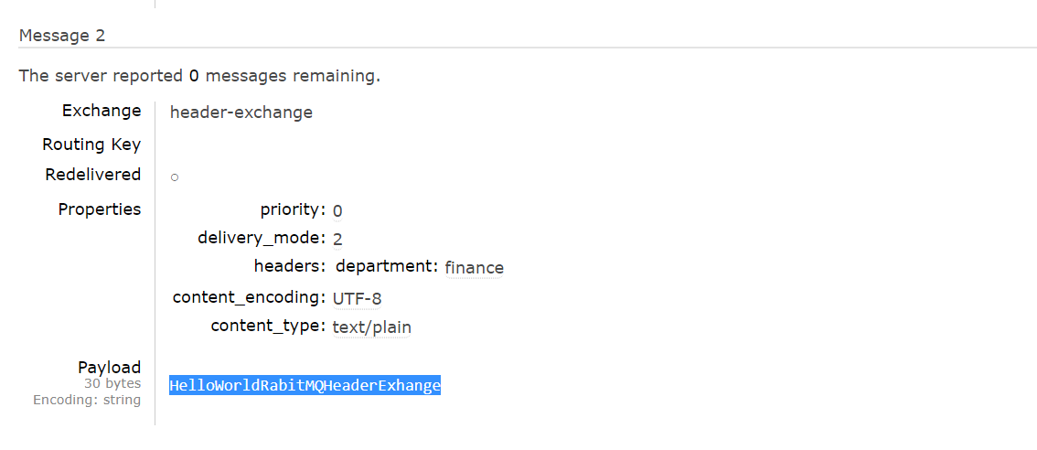
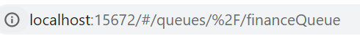
RABIT MQ Exchange Types with Topic Exchange q having AdminQueu
http://localhost:8080/rabitmq-rabbitmq/header/producer?exchangeName=header-exchange&department=admin&messageData=HelloWorldRabitMQHeaderExhange
http://localhost:8080/rabitmq-rabbitmq/header/producer?exchangeName=header-exchange&department=finance&messageData=HelloWorldRabitMQHeaderExhange

